Slide 1
Language, Diffusion, and Economic Development
Kyle Chan
Department of Sociology
Princeton University
May 6, 2016

Slide 2
Why does global inequality exist?

Slide 3
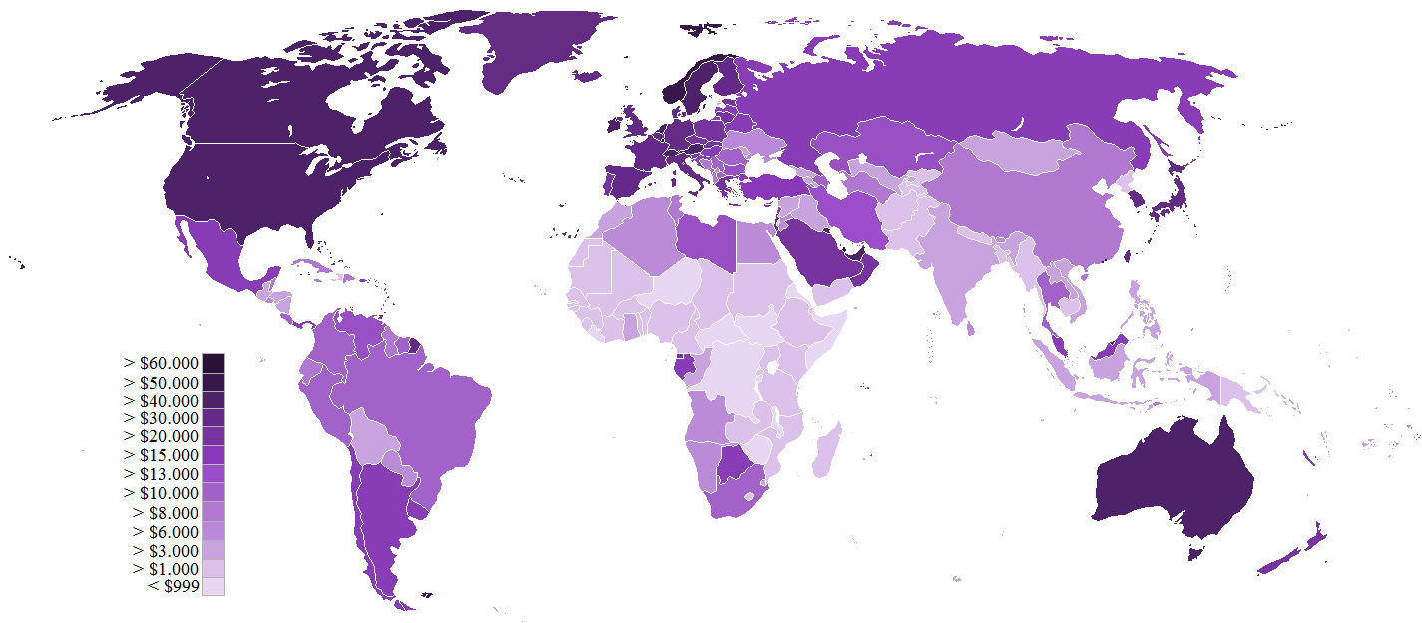
Source: Wikipedia (based on World Bank GDP (PPP) per capita 2014)

Slide 4
Why do patterns of development exist?

Slide 5

Geography
Religion
Trade Networks
Colonialism
Ideology
International Institutions
Culture
Communism

Slide 6
Technological diffusion across cultures?

Slide 7
?
Linguistic Distance
Patterns of Economic Growth

Slide 9
Standardized growth rates μ = 0 σ = 1

Slide 11
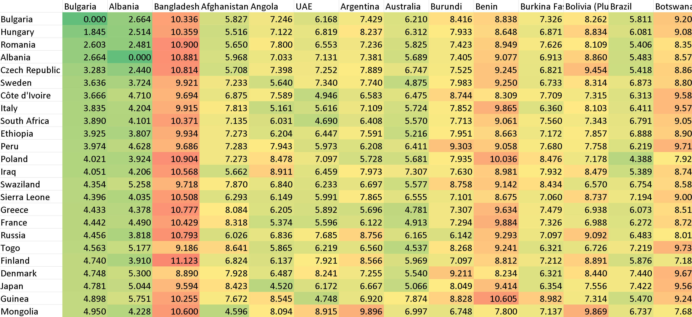

Slide 12
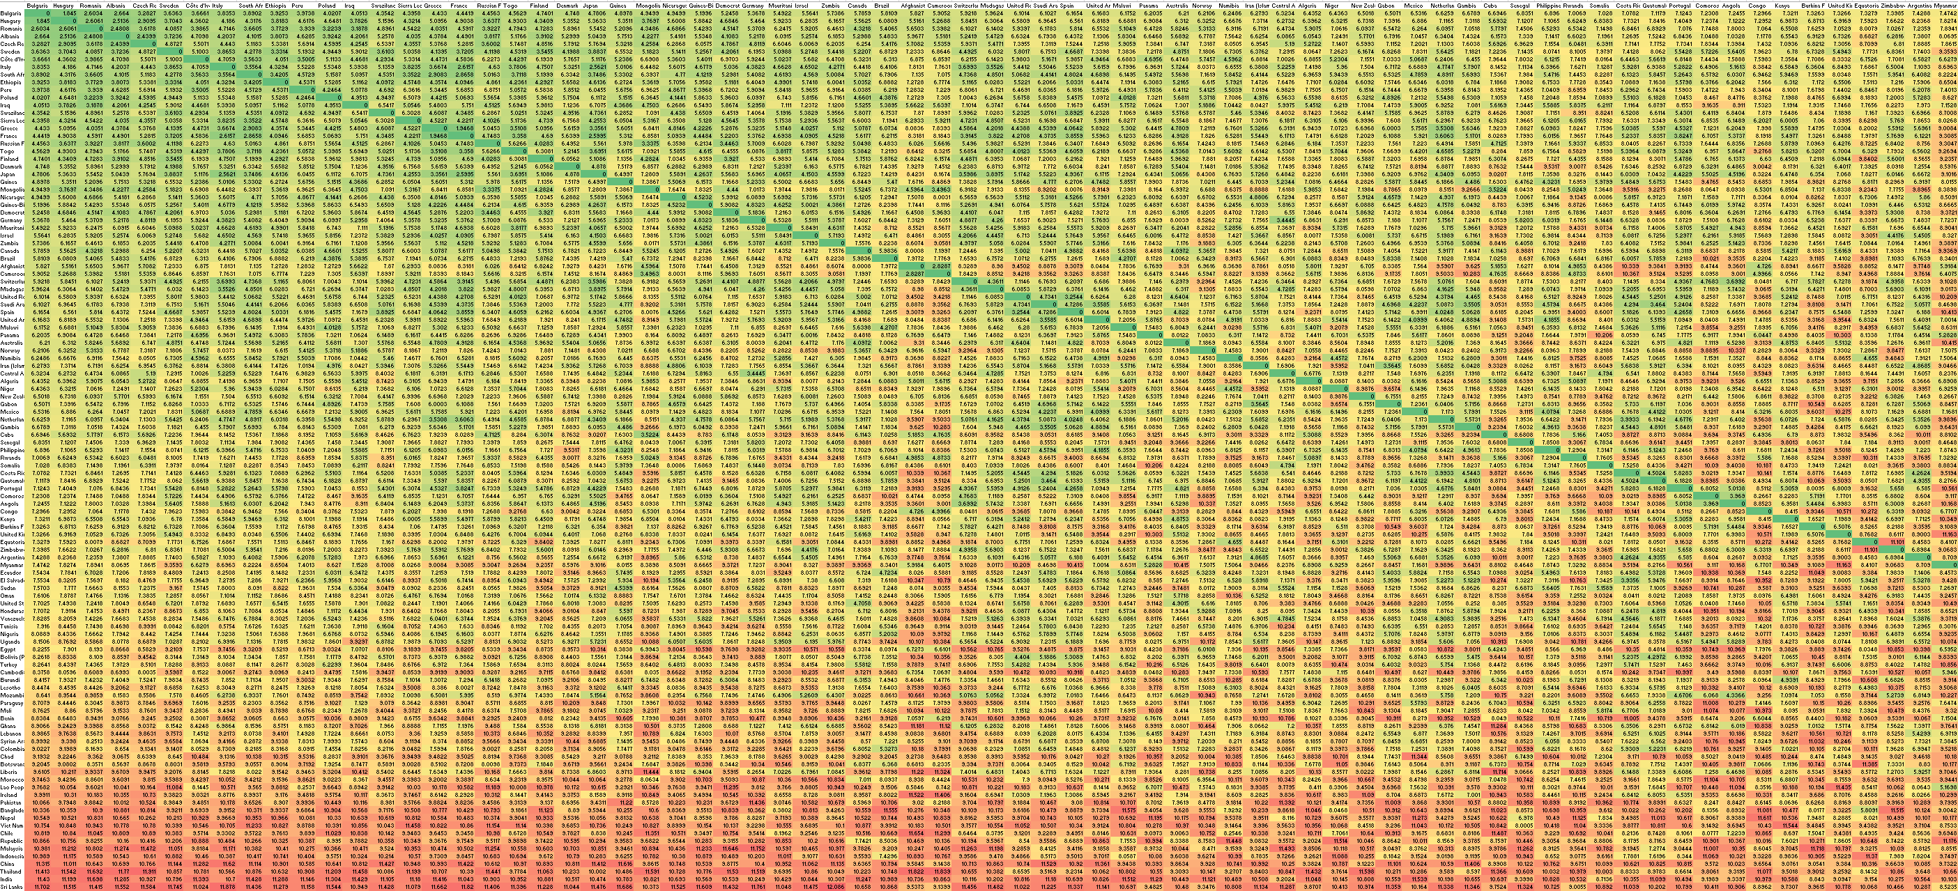

Slide 13
Mantel test

Slide 14

Mantel test

Slide 15
?
Linguistic Distance
Patterns of Economic Growth
Pearson r = 0.18
P-value ≤ 1 in 99,999

Slide 16
Thank you

